Slide 1

Acceptance Brief
Group 2:
Xavier Davis, Nabeel Hussein, Fleury Keigni Di Satchou, Shawn Sokoloski

Slide 2
Acceptance Brief Contents:
Summary of outstanding defects
Test results requirement grid
Recommendation
Last Revision: May 5th, 2018

Slide 3
Summary of Outstanding Defects
PinUp came together beautifully, yet there can still be found a chink in its armor.
Sporadically and inconsistently, it will display an error when a user attempts to create a PinUp account.
The homepage loads correctly, the “Sign Up” form is shown, and a verification email is sent to the provided email address, all per usual.
Upon clicking the link, the user is directed to an error page and cannot log in.
A screenshot of the error is provided on the following slide.

Slide 4
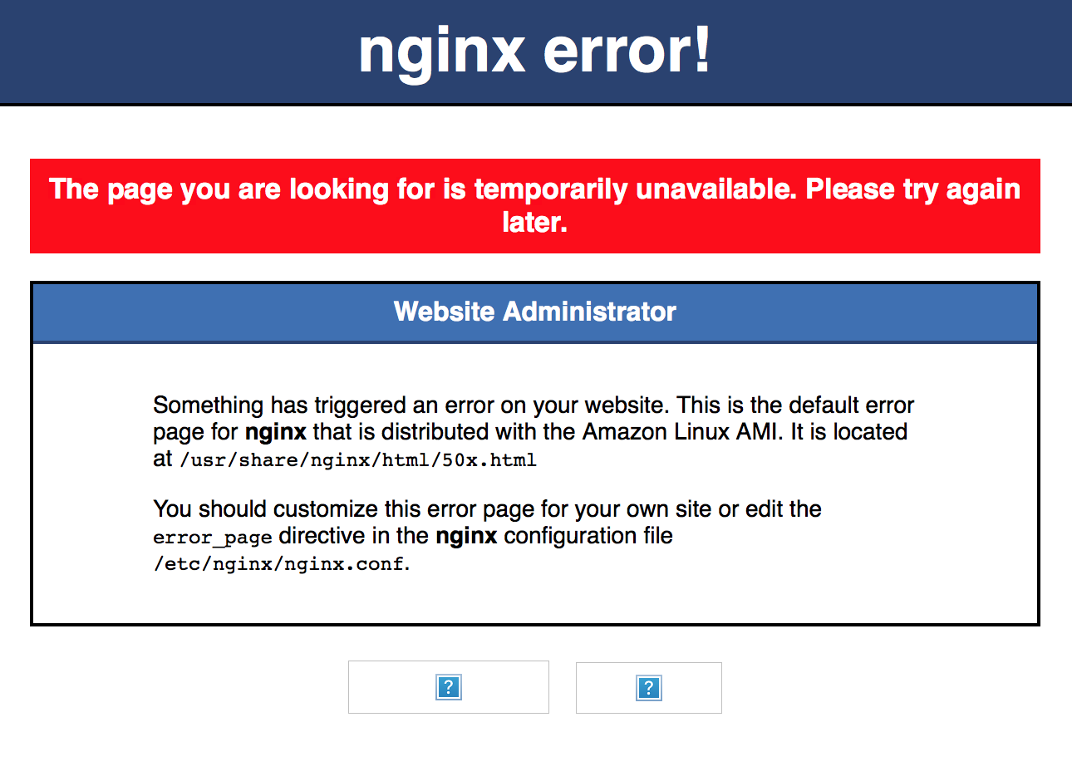

Slide 5
Summary of Outstanding Defects, continued
This error only seemed to occur every so often, and would sometimes stop happening for the same user after performing the same steps that produced the error in the first place.
Due to the inconsistency of the issue, the group was unable to resolve it before the project deadline. However, it does not happen frequently and usually resolves itself without any required action on part of the user aside from retrying sign up.
We customized the error to show our own message.
A screenshot of this new error message is on the following slide.

Slide 6
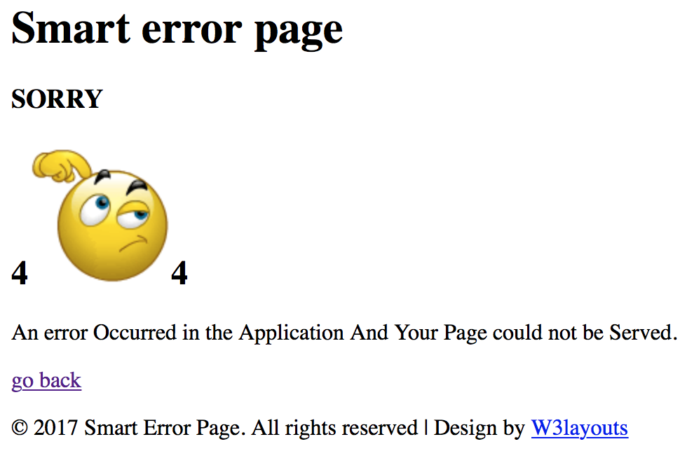

Slide 7
2. Test Results Requirements Grid
The following pages detail the test cases and results, in grid format.
This grid can be referenced in the “Group 2 Development Tracking and Test Cases” spreadsheet, also included in our submitted final materials.
We have also included Screenshots for all the Test Cases, which can be found in the “Test Case Results” pdf.

Slide 8
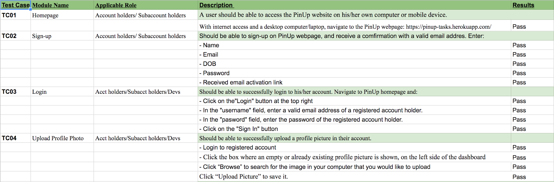

Slide 9
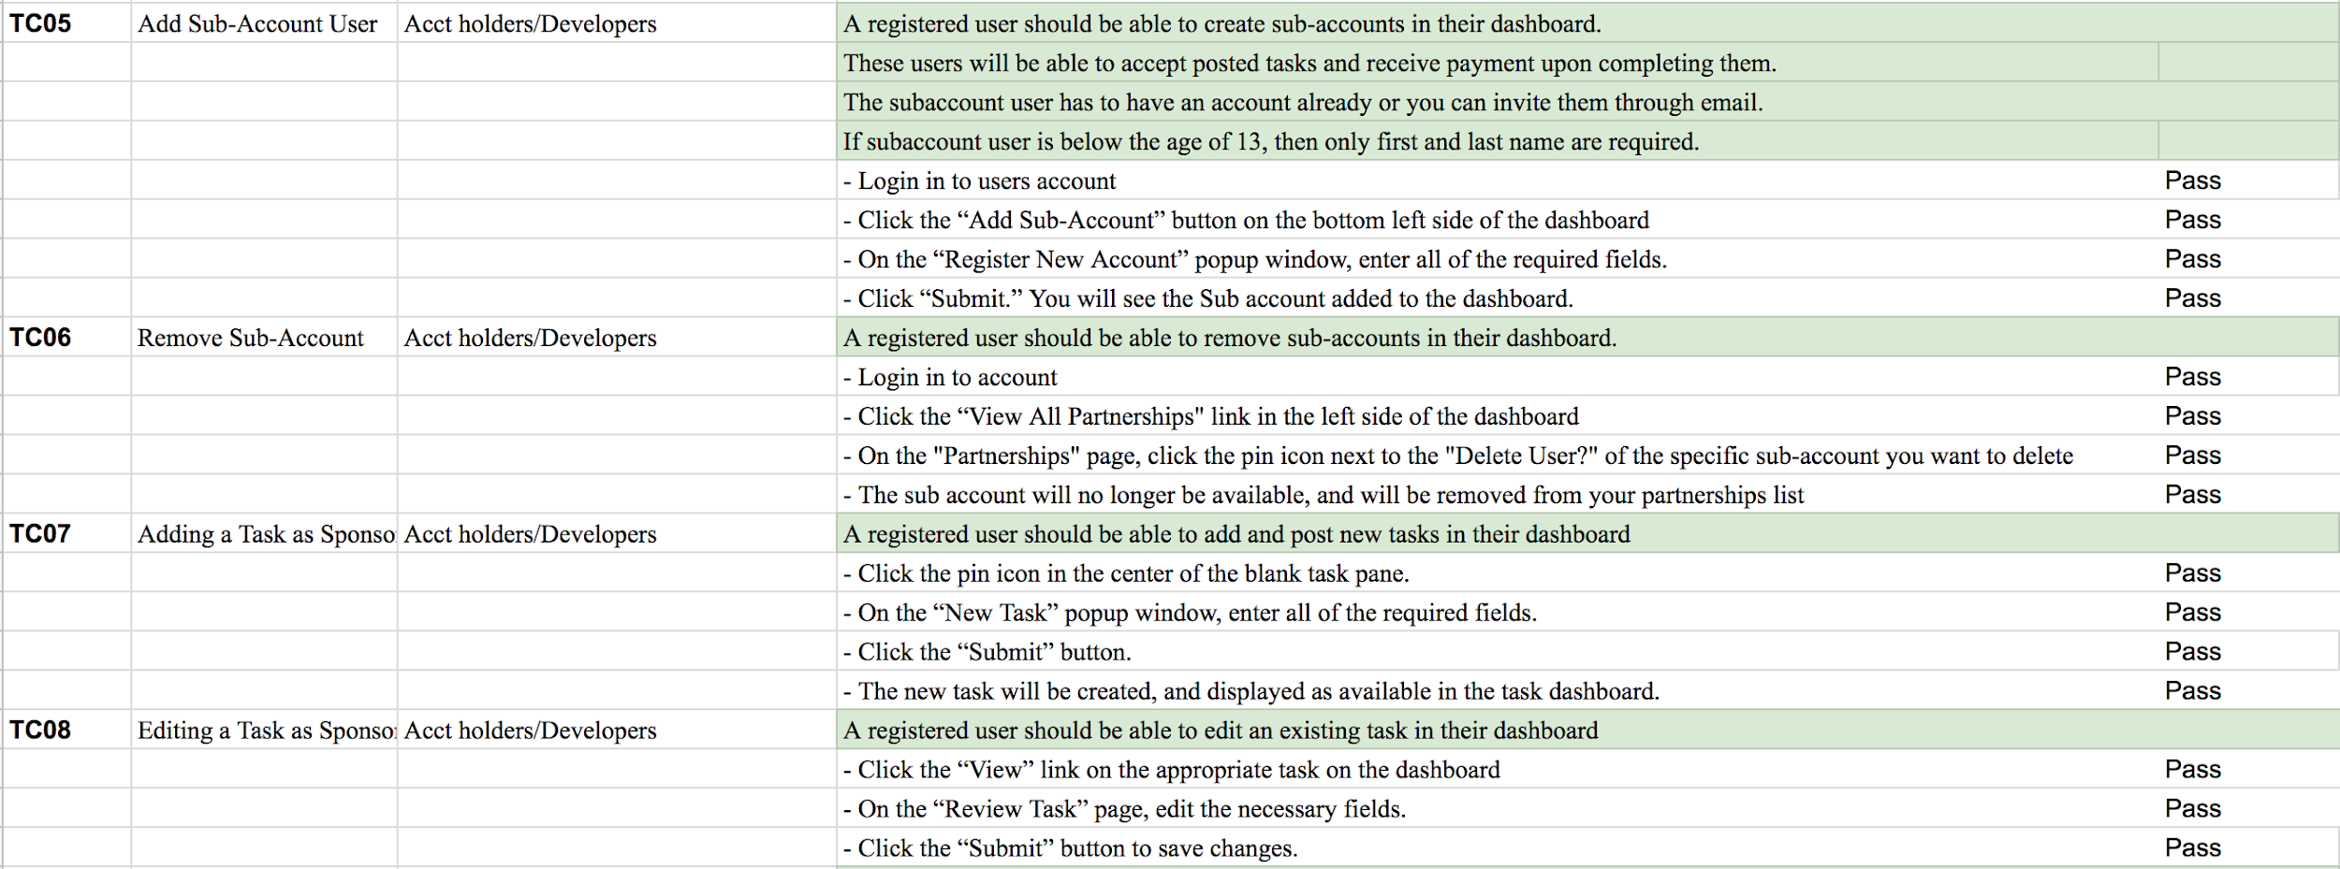

Slide 10
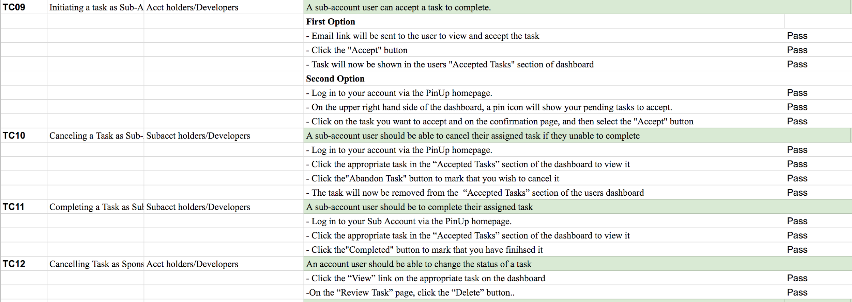

Slide 11
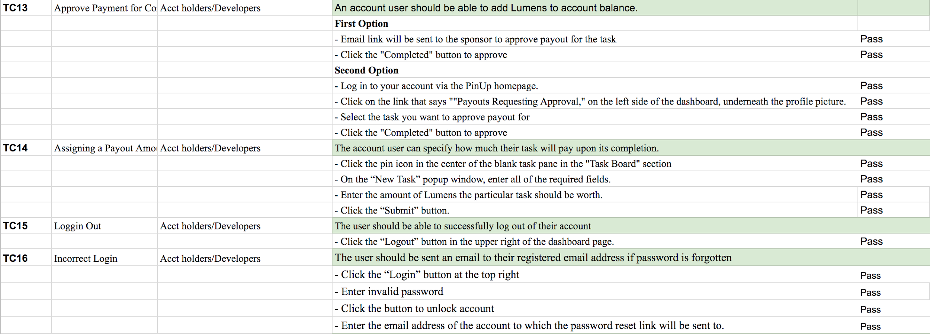

Slide 12
3. Recommendation
As detailed in the concluding segment of the Final Report, a widespread deployment of PinUp would be contingent upon setting up more adequate hosting services in order to handle the kind of traffic it would be encountering as a publicly available application.
Additionally, in light of the unresolved (though rare) Sign Up error, we would recommend additional maintenance before releasing PinUp to an application marketplace.
For the purposes of this class and the traffic of the professor and fellow students, this deployment of PinUp is adequate and recommended.

